Slide 1
Publishing Research Papers: Tips, Tricks & Caveats
Prof. Hend S. Al-Khalifa
King Saud University, Saudi Arabia
Contents were derived from many sources

Slide 3
About me
PhD in Computer Science (Southampton Univ., UK).
Full professor @ IT Dept. College of Computer and Information Sciences (KSU).
Head of iWAN research group, College of Computer and Information Sciences (KSU).
Consultant at MoE.

Slide 4
Professional Research Service
Associate Editor: Journal of King Saud University - Computer and Information Sciences (ECSI, Scopus).
Reviewer, guest editor and program chair for several national and International journals and conferences.
Publication Summary (2009-2019)
ISI and non-ISI -Indexed Published Journal Papers | 33
Conference Papers | 112
Authored Books | 2
Google Scholar Citations | 2662
Google Scholar h-index | 27

Slide 5
Topics to be covered
Basic considerations for publishing: Why and For Whom
Understanding of journal indexing services
Tips & general considerations in publishing
Some strategies for improving chances of publishing
Caveats for avoiding predatory venues

Slide 6
Before we start …
2926

Slide 7
Basic considerations for publishing: Why and For Whom

Slide 8
Why we need to publish?
Three Foci of Higher Education
Institute
Publication makes our research findings public, that is, opening to the examination and use by other scholars and knowledge users

Slide 9
Where to publish?
Indexed Journal
Level of Difficulty
Non Indexed Journal
Conference
Book Chapter

Slide 10
New Types of Publication
Lab Resources
Methods Articles
Protocols
Replications Studies
Negative Results
Video Articles
Data Articles
Software Articles
Hardware Articles
https://www.elsevier.com/authors/author-resources/research-elements-journals

Slide 11
Understanding of journal indexing services

Slide 12
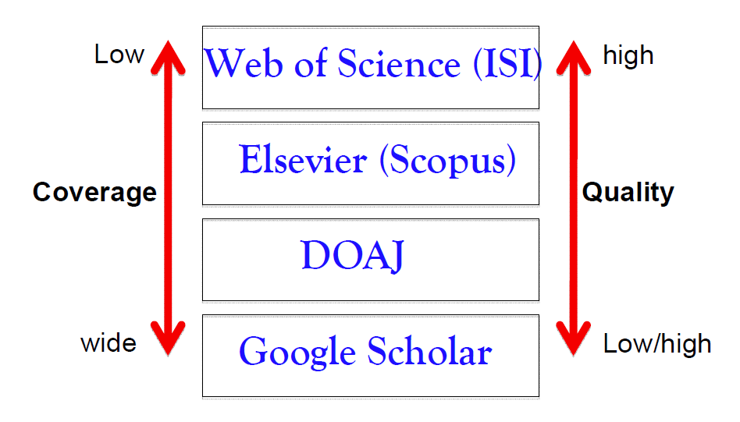
Major Journal indexing services

Slide 13
What is ISI?
ISI stands for Institute for Scientific Information (lSI)
It was founded by Dr. Eugene Garfield in 1960. It was part of Thomson Reuters company, Philadelphia, USA
Now it is owned by Clarivate Analytics (http://mjl.clarivate.com/ )
ISI covers thousands of academic journals which are available via ISI’s Web of Knowledge (part of web of Science) database service.

Slide 14
Top Three ISI-Indexing services
Science Citation Index (SCI) or Science Citation Index Expanded (SCIE)
Social Sciences Citation Index (SSCI)
Arts and Humanities Citation Index (AHCI)
A new indexing service launched in 2015 named as Emerging Sources Citation Index (ESCI)

Slide 15
How to find an ISI-Indexed journal
There is an ISI Master List http://mjl.clarivate.com/
Submit Journal Name or Print ISSN number (most of the time) of any journal to check its in the ISI database or not

Slide 16
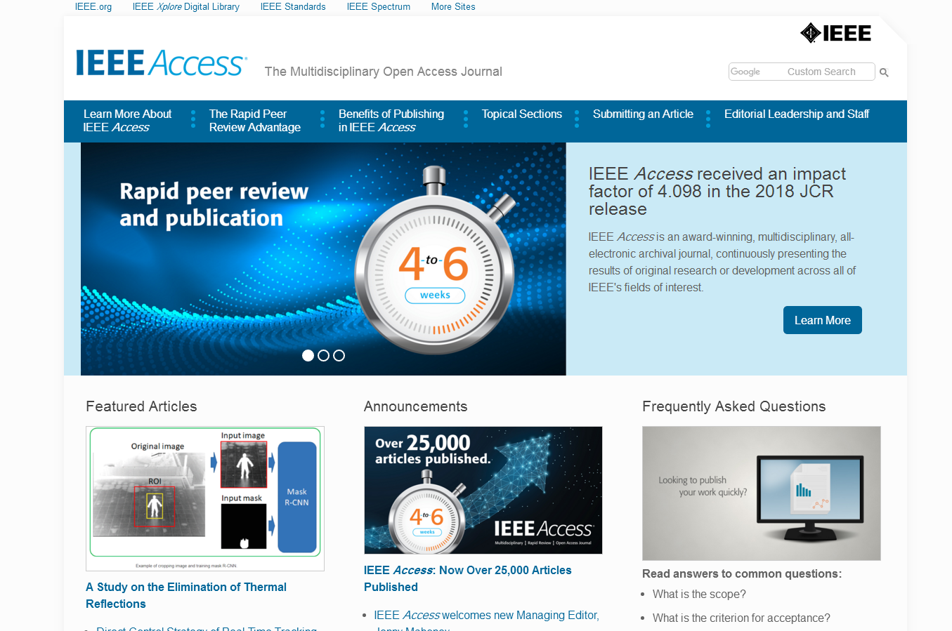
Example…

Slide 17
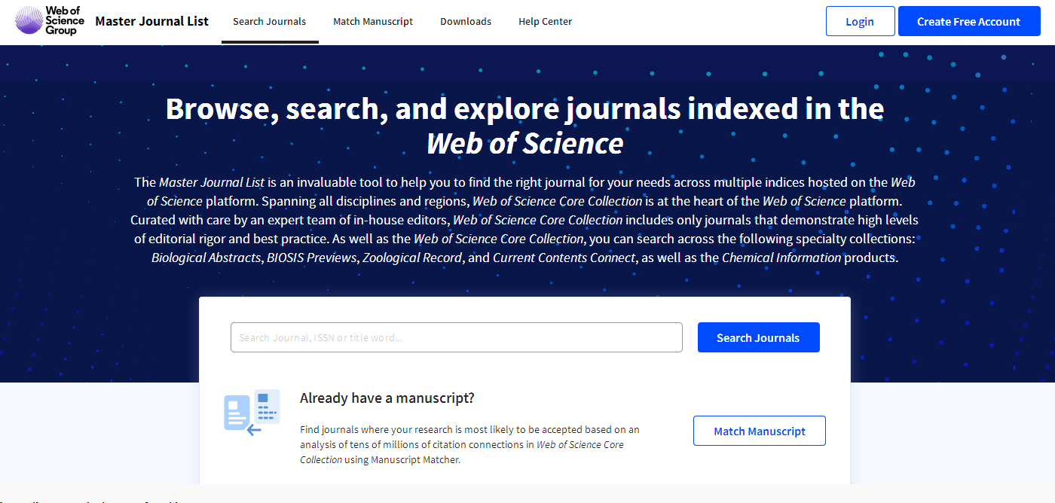
How to Check ISI journal
http://mjl.clarivate.com/

Slide 18
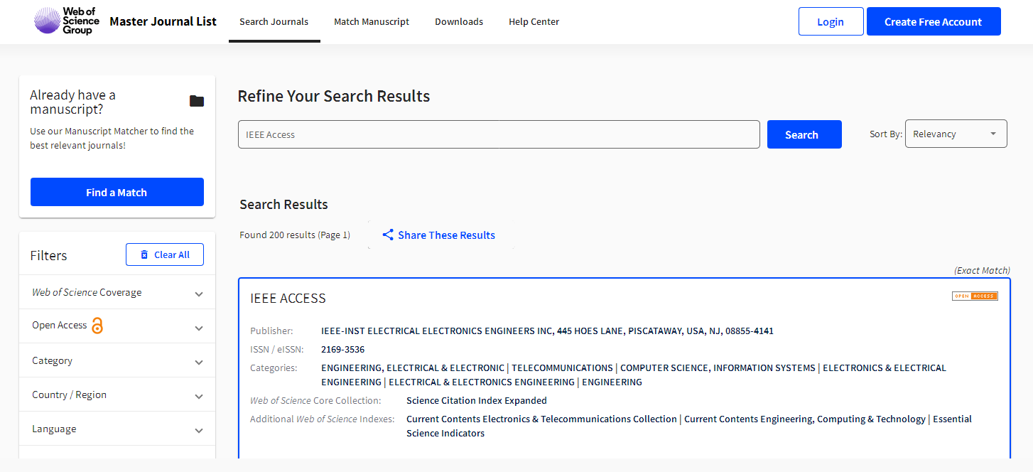

Slide 19
JCR (Journal Citation Reports)
JCR is an annual publication by Clarivate Analytics (previously Thomson Reuters)
JCR lists an impact factor for each of the journals that it tracks
The impact factor is a measure of the frequency with which the "average article" in a journal has been cited in a particular year or period in other ISI-ranked journals
The Impact Factor is published every June and corresponds to the previous year’s data.
http://help.incites.clarivate.com

Slide 20
How to check JCR Impact factor

Slide 21
How to check JCR Impact factor..

Slide 22
How to check Quartile in JCR
Quartile indicates where the journal rank lies within the subject category. The lower the quartile number, the better. For example, a journal in Q1 means it is within the top 25% of journals in that subject Category.

Slide 23
ISI-proceedings for Conference
lSI Proceedings is an index to the published literature of the most significant conferences, symposia, seminars, colloquia, workshops, and conventions in a wide range of disciplines.
It enables to track emerging ideas and new research in specific area.
It is known as Conference Proceedings Citation Index- Science (CPCI-S)
http://libguides.stir.ac.uk/c.php?g=530418&p=3628671

Slide 24
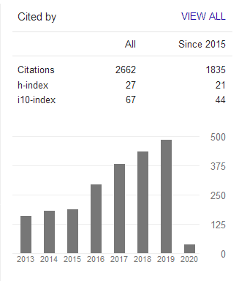
Google Scholar Indexing Service
H-index
The index was suggested in 2005 by Jorge E. Hirsch
The H-index quantifies both the scientific productivity and the scientific impact of a scientist
The index is based on the set of the scientist's most quoted papers and the number of citations that they have received in other people's publications

Slide 25
Scopus Indexing Service

Slide 26
DOAJ (Directory of Open Access Journal)

Slide 27
Unique Author Identifiers
In the context of research, unique author identifiers are one way to solve the problem of author ambiguity
Being able to accurately identify the author of a piece of research is valuable for researchers
because it means we can quickly find other work by the same author and ensure our own work is linked to him/her.
Three main unique author identifiers are: ResearcherID: Developed by Thomson Reuters Scopus Author ID: Developed by Elsevier and used in Scopus and related products ORCID: Developed by ORCID Inc., which is a non-profit, community-driven organization

Slide 28
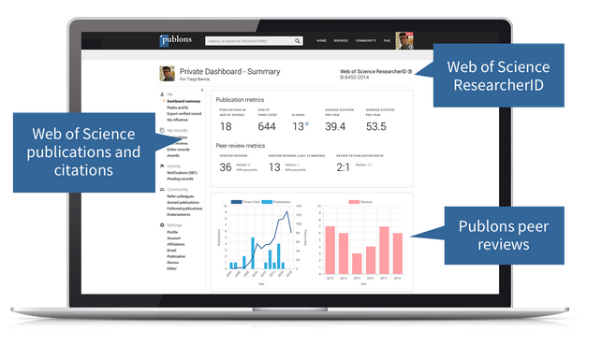
Researcher ID
Researcher ID (http://www.researcherid.com/) is used to identify authors and enables users to build a publication profile (h-Index) and generate citation metrics from Web of Science.

Slide 29
Scopus ID

Slide 30
ORCID
Orcid creates a central registry of unique identifiers for individual researchers.
It is now becoming a standard, and is supported by many publishers. It can be associated to Researcher ID and Scopus ID.

Slide 31
Tips & general considerations in publishing

Slide 32
What editors and reviewers look for in a research paper
Originality – what’s new about subject, or contributions
Relevance to and extension of existing knowledge
Research methodology – are conclusions valid and objective?
Clarity, structure and quality of writing
Sound, logical progression of argument
Theoretical and practical implications - the ‘so what’ factors
Experiment results- comparing with other works
Recency and relevance of references
Adherence to the editorial scope and objectives of the journal

Slide 33
Certain important points before sending the paper
“Many papers are rejected simply because they don’t fulfil journal requirements. They don’t even go into the review process.”
Identify a few possible target journals/series but be realistic
Follow the Author Guidelines – scope, type of paper, word length, references style, etc.
Find where to send your paper (editor, regional editor, subject area editor)
Send an outline or abstract and ask if this looks suitable and interesting (or how it could be made so)
Read at least one issue of the publication – visit your library for access

Slide 34
Some Useful Journal Finder Links
https://www.journalguide.com/
http://jane.biosemantics.org/index.php
http://journalsuggester.springer.com/
https://www.edanzediting.com/journal-selector
https://mjl.clarivate.com/home

Slide 35
Some strategies for improving chances of publishing

Slide 36
Strategies
Strategy 1: Understand the chemistry of the “scholarly search.”
Strategy 2: Realize the importance of theory and literature
Strategy 3: Start writing during the initial stages (For doctoral program)
Strategy 4: Master the core concepts of impact factor, peer review, contribution to knowledge, and scientific knowledge
Strategy 5: Build networks and collaborations
Strategy 6: Check the plagiarism before submission

Slide 37
Caveats for avoiding predatory venues

Slide 38
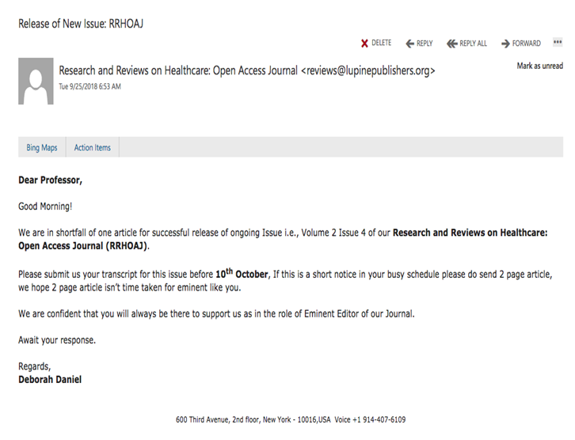
Fishy email...

Slide 39
Fishy email...

Slide 41
Predatory Publishers/Venues
Predatory publishers*: publish counterfeit journals to exploit the open-access model in which the author pays. These predatory publishers are dishonest and lack transparency. They aim to dupe researchers, especially those inexperienced in scholarly communication.
Predatory journals include:
hijacked journals
deceptive journals
low quality journals
*Beall, J. (2012) “Predatory publishers are corrupting open access”, Nature, vol. 489 iss. 7415.
http://www.nature.com/news/predatory-publishers-are-corrupting-open-access-1.11385

Slide 42
Deceptive Journal
Categories of Deceptive Journals
Pseudo-scholarly journals: These are journals that falsely claim to offer authors real and meaningful editorial services (e.g. claim peer review and impact factors).
Masqueraders journals: adopt titles designed to imply affiliation with a legitimate- and prestigious-sounding scholarly or scientific organization that does not actually exist (e.g. American Medical Society Journal or Journal of the Royal Society of Physicians).
Phony journals: These are journals that falsely claim to publish articles based on legitimate and dispassionate scientific or scholarly inquiry, when in fact they publish only articles that promote a product or support a specific commercial, political, or other agenda. (e.g. Australasian Journal of Bone and Joint Medicine, which was published by Elsevier).
http://osiglobal.org/2019/03/19/osi-brief-deceptive-publishing/

Slide 43
Not just open access publishers
Springer and IEEE removed more than 120 papers after Cyril Labbé of Joseph Fourier University in Grenoble, France, discovered computer-generated papers published in their journals.

Slide 44
Office location of OA journal in a UK city as listed on their website

Slide 45
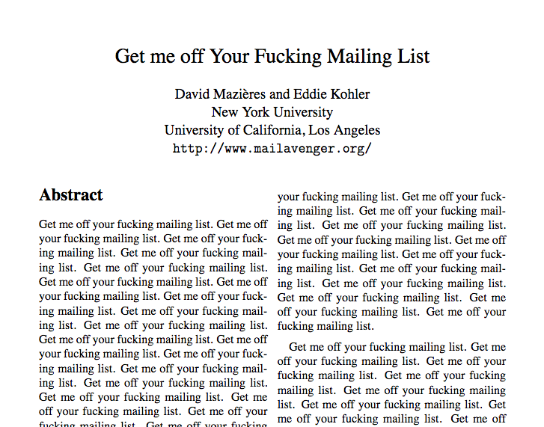
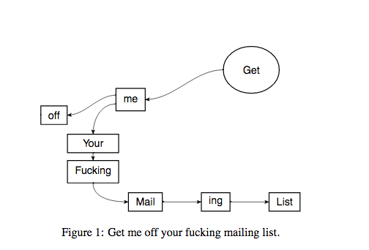
An actual article accepted by the International Journal of Advanced Computer Technology! (An irritated researcher submitted it after being repeatedly spammed by the journal.)
The “peer reviewer” called it “excellent”!
Read more.

Slide 46
Why Would Anyone Publish There?
Some authors know what is up and publish there anyway (due to rejections from other journals, job pressures to publish quickly and/or voluminously, etc.).
Some authors are duped into publishing there.

Slide 47
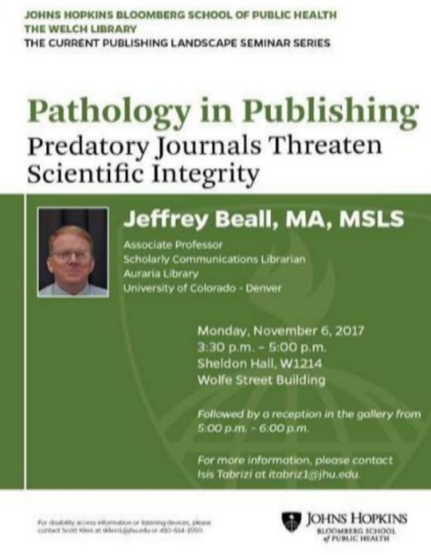
Heard about Lists?
Heard about Beall’s List?*
Highly problematic: it reflected his biases and conflated lower-quality and amateurish with predatory.
Any attempt to create a comprehensive list of fake journals would be similarly problematic.
Forget lists!
*https://scholarlyoa.com/publishers/

Slide 48
Evaluate!
It is not just fake journals you want to avoid.
You want to avoid publishing in journals that don’t meet your quality standards, that you wouldn’t be proud to publish in and list on your CV.
You owe it to yourself and your career to evaluate any journal you’re thinking of publishing in. (Also evaluate the journals you read!)

Slide 49
No Lists? But I Like Lists!
There are other lists that can help:
1) lists of vetted journals 2) lists of journal traits to consider

Slide 50
“Pre-Approved” OA Journals
Directory of Open Access Journals
doaj.org
Browse or search 14,000+ open access journals that have been vetted for transparency and quality control.
Most do not charge APCs.

Slide 51
“Pre-Approved” OA Publishers
Open Access Scholarly Publishers Association oaspa.org
Members are vetted and must adhere to a code of conduct.

Slide 52
“Pre-Approved” OA Publishers
Committee on Publication Ethics publicationethics.org
Members are vetted and must adhere to a code of conduct.

Slide 53
Things to Look Out For & Consider
Open Access Journal Quality Indicators bit.ly/OAindicators
Think. Check. Submit. thinkchecksubmit.org
Stop Predatory Journals https://predatoryjournals.com/

Slide 54
Some Red Flags*
Email solicitations, especially flattering ones
Fake “reminder” or “follow-up” emails
Editors with Gmail/Yahoo email addresses
Claims of super-fast peer review
Lack of transparency about fees
Inconsistencies (e.g., about geographic location, editorial board membership)
*Berger, Monica. “Everything You Ever Wanted to Know About Predatory Publishing but Were Afraid to Ask.” https://academicworks.cuny.edu/ny_pubs/141/

Slide 55
More Red Flags
Copycat titles
Missing/faked ISSN
False claims about impact factor (ISI-index https://isindexing.com/isi/ , Copernic)
Boasts about metrics that don’t exist
False claims about inclusion in library databases
Boasts about inclusion in Google Scholar, etc.
Berger, Monica. “Everything You Ever Wanted to Know About Predatory Publishing but Were Afraid to Ask.” https://academicworks.cuny.edu/ny_pubs/141/

Slide 56
Other Things to Consider
Depending on a variety of factors, these may or may not be red flags:
Extremely broad scope
Newness or incompleteness
Article quantity
Appearance of website
Quality of writing on website (especially if journal claims to be from US, UK, Canada, etc.)
Berger, Monica. “Everything You Ever Wanted to Know About Predatory Publishing but Were Afraid to Ask.” https://academicworks.cuny.edu/ny_pubs/141/

Slide 57
Think critically. Also go with your gut.

Slide 58
Fake Conferences Too?
In short: ditto.
Think. Check. Attend. thinkcheckattend.org

Slide 59
Fake Book Publishers Too?
Scam book publishers often target recent graduates, offering to publish their thesis or dissertation.
Beware of publishers you haven’t heard of.
Beware of publishers that don’t have an extensive review and revision process.
Publishing with a book mill will hurt your chances of later publishing with a reputable press.

Slide 60
Thank you! Q&A
@hend_alkhalifa
hendk@ksu.edu.sa

