Slide 1
CHALLENGES IN SCIENTIFIC PUBLICATION IN HIGH QUALITY JOURNALS
Dr. S. Neelamani
Senior Research Scientist
Coastal Management Program
Environment and Life Sciences Research Centre
KISR

Slide 2
Why to publish our scientific works in Reputed Journals?
Promotion
Research responsibility
Research growth
Recognition (Self and Country)

Slide 3
Why to publish our scientific works in Reputed Journals? (Contd..)
Joy of contributing praiseworthy knowledge to the society
To let the scientific world know that we are innovators in a particular area

Slide 4
Why to publish our scientific works in Reputed Journals? (Contd..)
Enhance KISR image
For getting Ph.D. degree
Allow other researchers to confirm and extend your results

Slide 5
1. Happy when your work appears in a reputed Journal 2. Feel pleased when someone tells you that they read your article and felt it is useful for him/her work 3. Feel happy when someone from somewhere asks you a copy of your article 4. Feel proud when you see your paper is cited by someone in his/her article 5. Fell delighted when someone comes to you (say in a conference) and ask you “You are so and so and that particular nice and useful paper is yours”
Why do we like to publish our scientific works in Journals? (Contd…)
- Other feel good factors

Slide 6
1. Is the paper worth writing? 2. What do I have to say (or) what is the message of the paper? 3. Is it worth saying (or) What is the new result or contribution that you want to describe? 4. What/Who is the audience for the message and What do you want to convince people of? 5. What is the right format for the message? 6. Where should I publish the message? 7. What are the requirements so that my paper is published?
HOW TO START?
THINK AND PONDER FIRST!!

Slide 7
Where do we want to publish?
Journals with high impact factors.
Highly reputed international conferences

Slide 8
Is it easy to publish our research results in a reputed Journal?
Not at all.
Communication of research results through publication in a scholarly journal is an essential and intrinsic component of science.
As researchers, we need to communicate not only to peers but also to laypersons and media.
Thus there arises a need to be more proficient in the field of communication.
Written communication is more difficult to learn.
The ultimate proof that one has arrived in the field of science lies in one’s success in written communication.

Slide 9
Why it is not easy to publish in Journals with High impact factors?
Their expectations are very high.
Reviewers review the papers for finding out the reasons for REJECTIONS.
They will give hundreds of reasons for rejections.

Slide 10
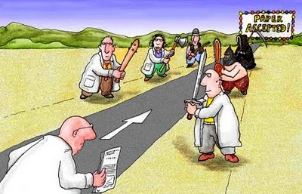

Slide 11
How do we make sure the paper gets accepted for publication in a reputed journal?
Make sure the information is NEW and useful for the global society.
Impress on the usefulness of the work for the socioeconomics.
Make sure you are submitting the paper to the RIGHT journal (Your work may be fantastic but the journal you have selected may not be in the subject area of your work).

Slide 12
How do we make sure the paper gets accepted for publication? (Contd…)
Prove that the data used for the paper is accurate/authentic.
Prove that the literature review is up to date.
Make sure the language of writing is acceptable.

Slide 13
How do we make sure the paper gets accepted for publication? (Contd…)
Make sure the Plots/Figures in the paper are impressive.
Make sure the tables are well organized.
Make sure the conclusions are appealing.
Follow the paper writing instructions meticulously (Which is different for each Journal).

Slide 14
What is that I should do?

Slide 15
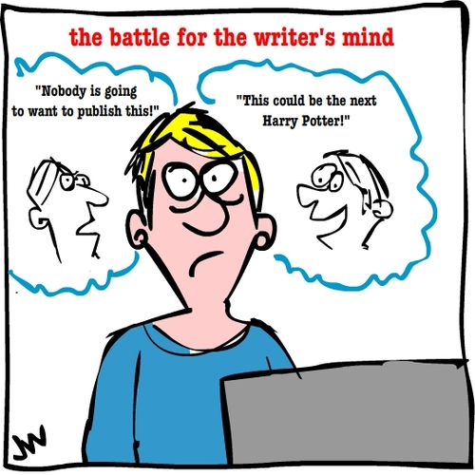

Slide 16
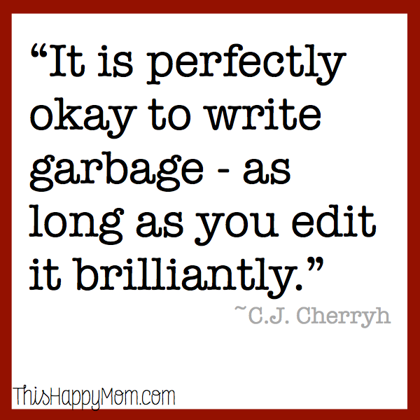

Slide 17
Some possible reasons for paper rejection
The research does not make a sufficiently large contribution to the BODY OF KNOWLEDGE.
The conceptual framework (i.e. Literature review) is not well developed.
The methodology used in the study is seriously flawed (e.g. the sample is too small or the reliability and validity of the measures used are questionable)

Slide 18
Some possible reasons for paper rejection (Contd…)
Not within the scope of journal
The writing style is disorganized / Article is not structured properly.
Unsupported claims in the paper
Not referencing prior papers
Results not significant (The use of the study result is insignificant)

Slide 19
Is the institute and geographical location of the work place important?
It seems YES. (I feel this from my own experience)
The reviewer’s first impression of a paper from a reputed institute is “POSITIVE”.

Slide 20
Is it true that a Scientifically impressive paper gets rejected because of poor language?
YES.
It is hence important that a native English speaker reads the paper for Grammar correction before submission.

Slide 21
Other items you have to keep in mind before submitting a paper for review
Subject area of the journal.
Fairness and rapidity of the editorial process
Probability of acceptance
Publication cost

Slide 22
Some important messages for the beginners
Writing a good article for journal is an art
One will become an expert only after many years of experience
At the same time, you do not have to be an award winning novelist or rousing poet
You need to be organized, accurate, clear and concise in your writing

Slide 23
Some important messages for the beginners (Contd…)
The success or failure of an academic article is determined long before the first word is written or the first letters are typed.

Slide 24
What is that the Journal Editors look for?
Journal editors will want to know what new knowledge your manuscript is bringing to the scientific field
Publishing your article helps to increase the impact factor of the journal
More number of people will read and use your results

Slide 25
A good quote
“Making the simple complicated is commonplace; making the complicated
simple, awesomely simple, that’s creativity.”

Slide 26
How to improve the skill for article writing?
Keep writing the articles for journals (Experience)
Become a Reviewer of articles for journals
Read as many journal articles as is possible (Basic requirement before preparing a research proposal)

Slide 27
Some KISR Researcher’s important Queries
I work on problems related to Kuwait.
Will it get accepted for an High impact international Journal?

Slide 28
What to do?
Communication skill
Do a thorough literature review
Make sure you have new results, which is not existing in the literature
Select the right Journal
Make sure the title is Catchy
Make sure the abstract contains the 6 essential elements
Accuracy of the data

Slide 29
What to do? (Cont…)
Read the Author Instruction carefully
Make sure the manuscript is prepared according to the format expected by the journal
Make sure the information is not published earlier
Make neat and clear Figures
Spell check the manuscript

Slide 30
What to do? (Cont…)
Appealing conclusions
Acknowledge
References according to the Journal format
Polite reply with Editor
Refer few recent papers from the journal you are going to submit (Editors like that-It will increase the impact factor of that journal)
Suggest further research directions (Readers working in that area like that)
Select the paper title and abstract after completing the full paper

Slide 31
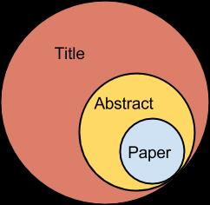
Coverage of scientific articles

Slide 32
What to do? Communication skill
Improve your communication skill
Think what you want to communicate
Write it
Show it to your colleague
Ask him/her to read
Ask him/her what he/she understood by reading the text
Verify his/her reply is exactly same as what you were thinking

Slide 33
If communication skill is not up to date
Attend a special training to improve the communication
Practice first with journal of low impact factor

Slide 34
Literature Review
You need a lot of time to review, understand and extract useful information from the literatures
Select a place, where disturbances are less and spend few days for the literature review

Slide 35
Right Journal
Go through the KISR approved Journal list
Select the topics appropriate to your research
Go through the Aim of the journals
Zero down to the right journal

Slide 36
Before submission
After completion of the manuscript, leave everything aside for few days
Read the manuscript again and make modifications
Give it to an expert to read and give his/her opinion on science and language

Slide 37
What not to do?
No hurry-up at any stage (Data collection / Analysis / Literature Review / manuscript preparation etc.)
No repetitions (Sentences / meanings etc.)
Don’t ask the editor to accelerate the review process (You are waiting for paper acceptance for promotion etc.)
Polite reply for reviewers comments (Even if a reviewer is wrong in his comments)

Slide 38
What not to do? (Contd..)
Don’t delay responding to editors
Thank editors and reviewers (They do the work as an academic and social service).
Don’t claim the work is completely new, unless you are 100% sure

Slide 39
The general material content of a journal paper
Title of the article
Author names and their contact details
Abstract
Key words
Introduction
Literature review and motivation
Aim and objectives

Slide 40
The general material content of a journal paper (Contd…)
Methodology
Results and discussions
Case study or workout examples (If needed)
Conclusions and recommendations
Future works
References
Acknowledgements
Table / Graph / Illustrations
Appendix
Abbreviations

Slide 41
Abstract
7 elements of an Abstract:
Start with a brief theme sentence
Main aim and purpose of the study
Academic or practical importance of the study
Methodology used
Main findings
Statement of conclusion
Practical implications

Slide 42
Introduction Six important elements
Broad theme or topic of the study
Academic and practical importance (Provide a convincing answer for the question “Why should anyone give attention on this article?”
Summary of available literature (Cite the most important previous study relevant to current research)
Indicate most important gap / inconsistencies / controversies in the literature that the current study will address
Clearly indicate the research problem/question to be addressed, specific research objectives, context and unit of analysis
Outline of the structure of the rest of the article

Slide 43
Basic tips for good Literature Review
Start from the latest State of art review article.
Free web sites are available. Example: Google scholar
KISR library has wonderful facility

Slide 44
Challenges in the Literature Review
Finding appropriate literature on specific topic
Managing the information
Presenting a logical, synthesized, user friendly review of current knowledge

Slide 45
Methodology
How did you do?
What did you do?

Slide 46
Results: What did you find?
Discussions: What does it all mean?

Slide 47
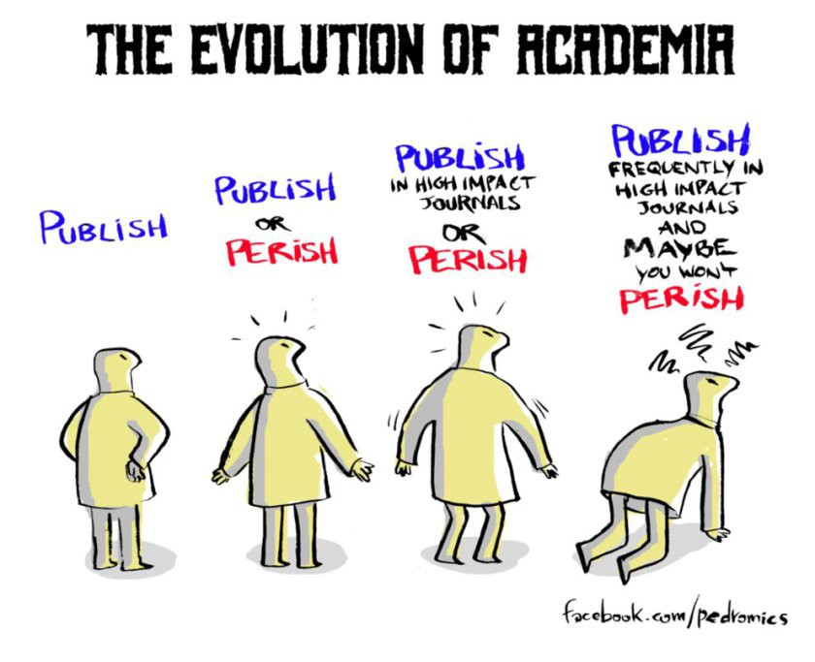

Slide 48
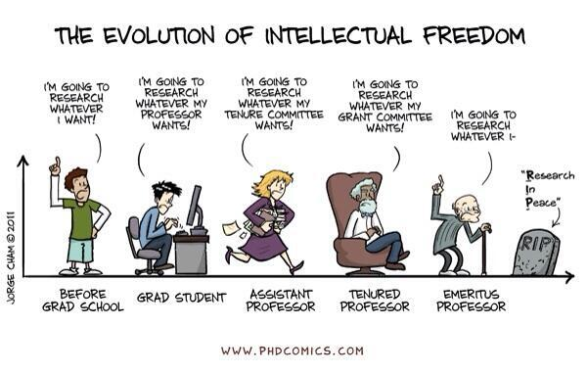

Slide 49
BEST WISHES FOR
SUCESSFUL PUBLICATIONS
IN HIGH QUALITY
JOURNALS

